Slide 1
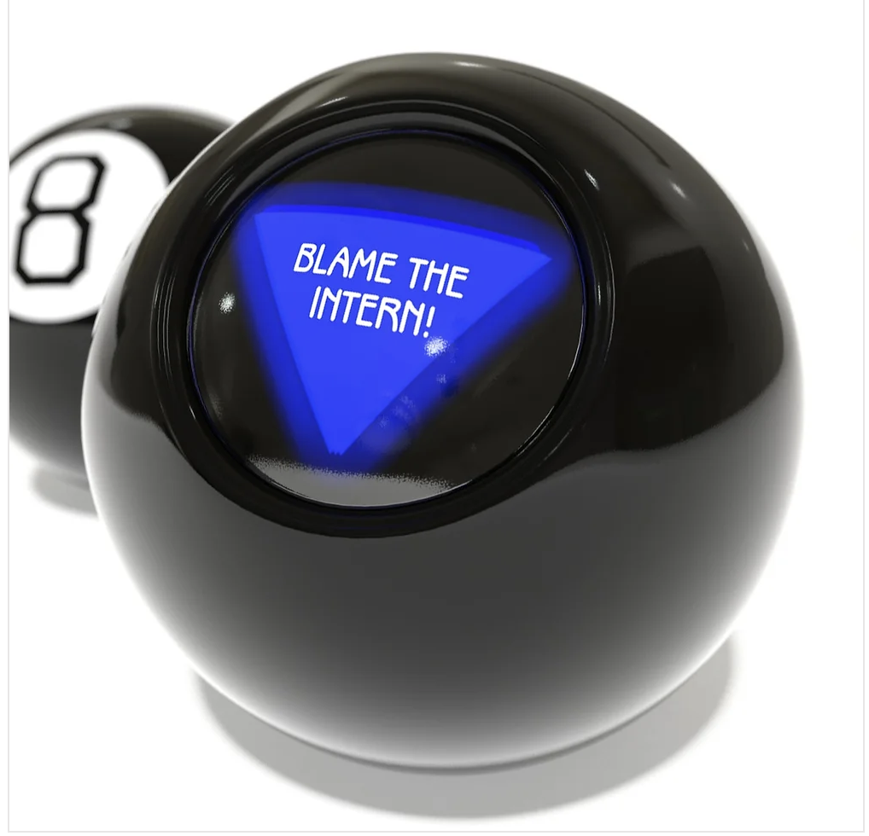
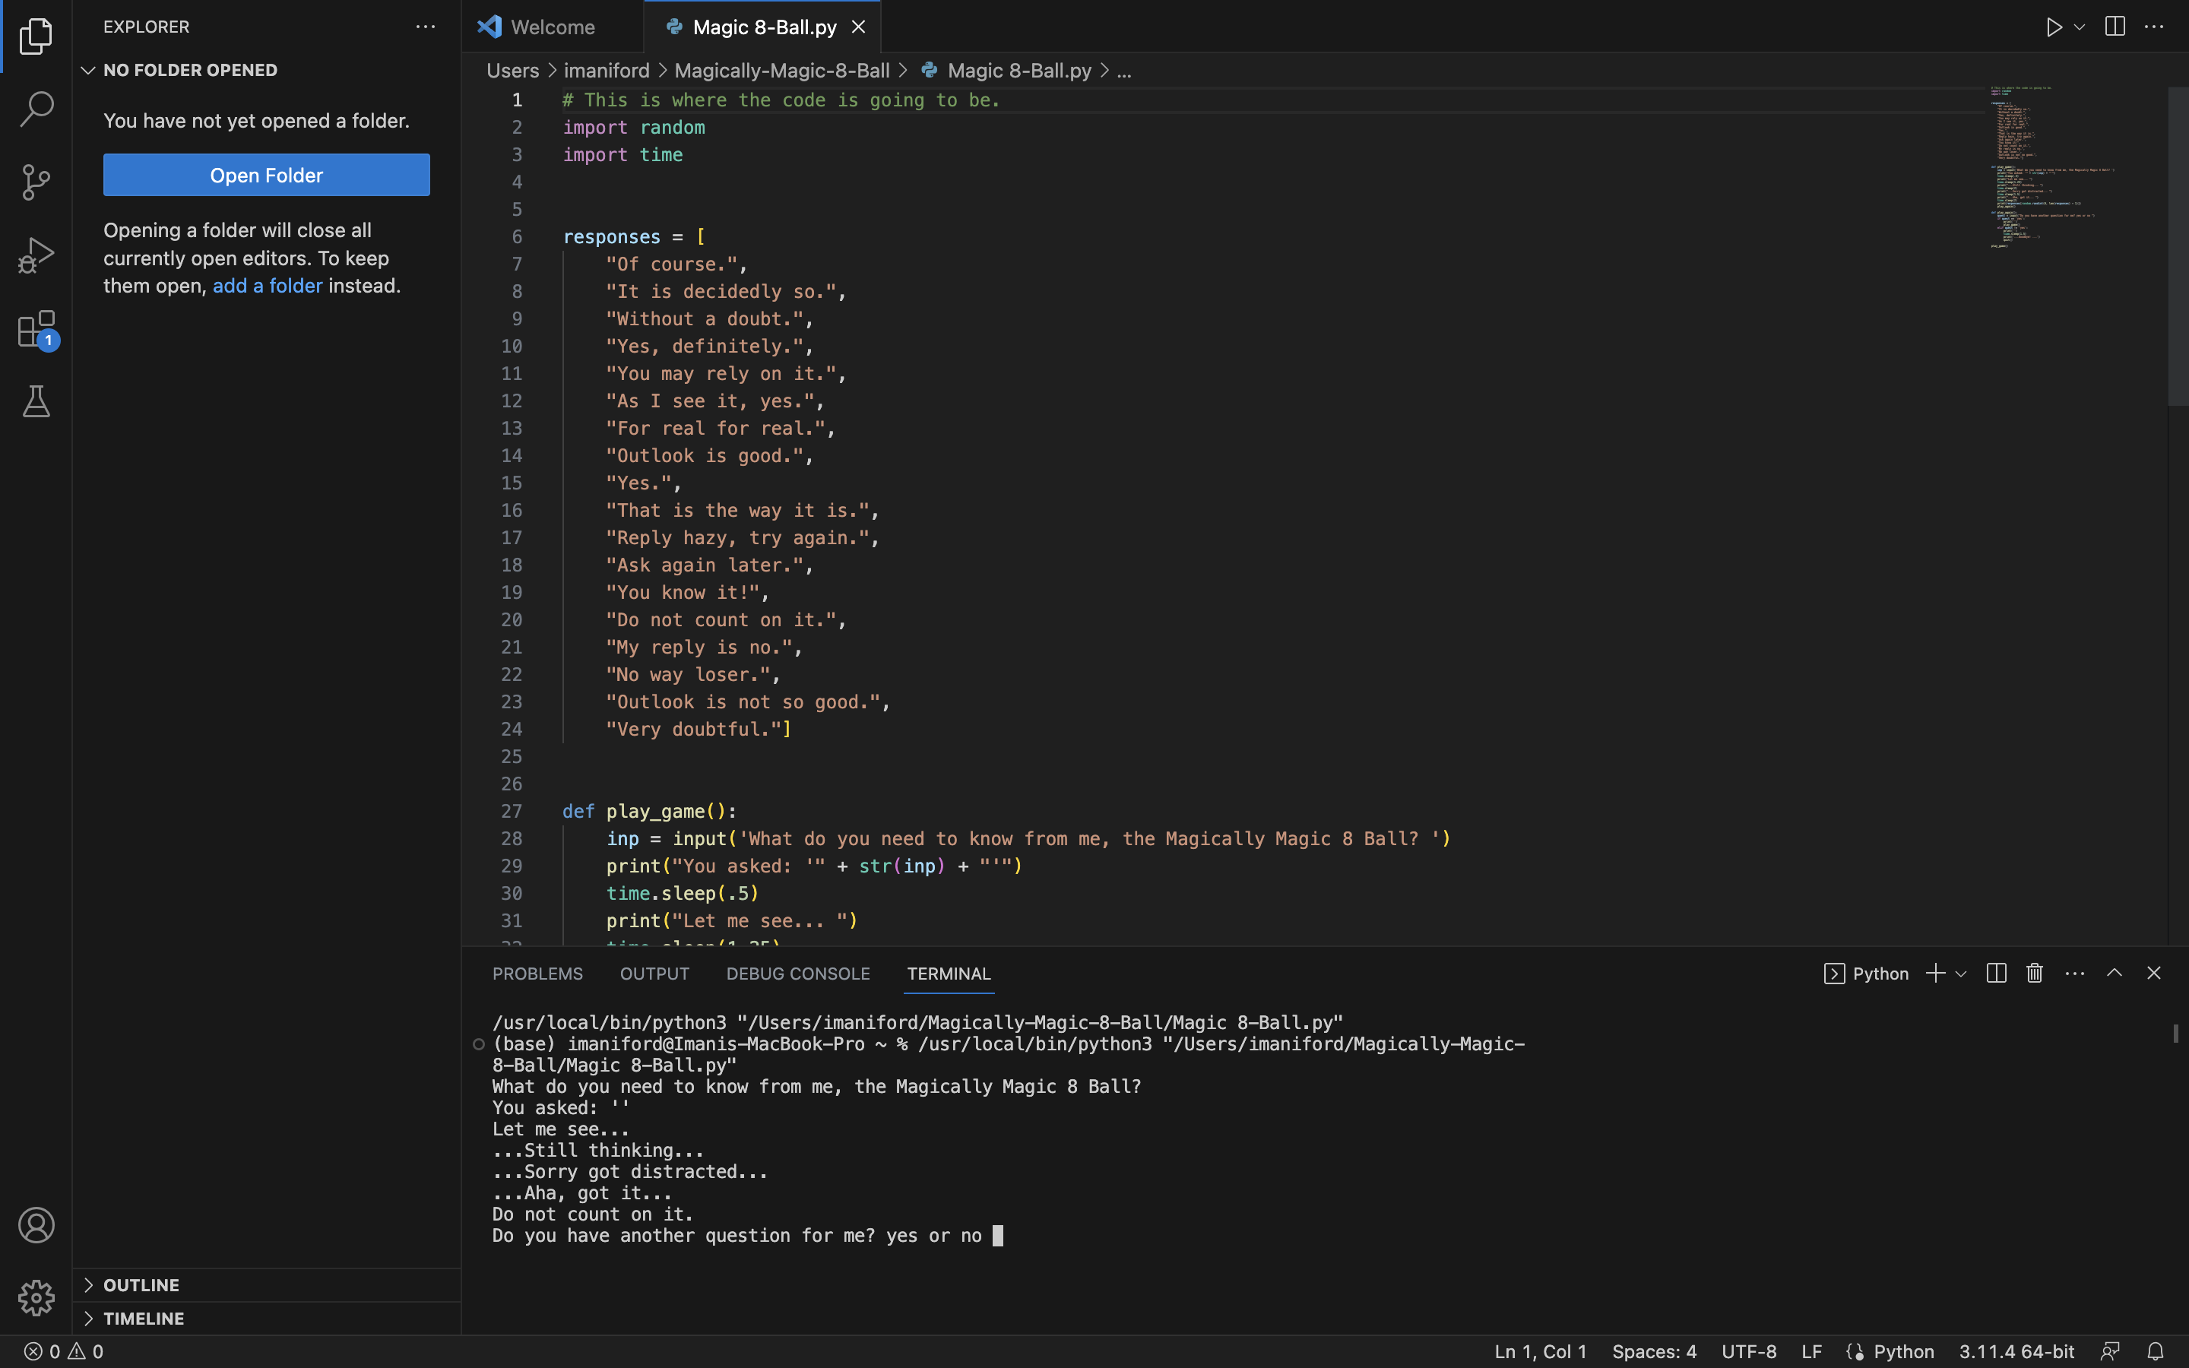
Magically Magic 8 Ball
Kaiti Holcomb & Imani Ford
The Magically Magic 8 Ball is unique because fortune tellers are not the only ones who can use it! The everyday person can use this program to predict what their future looks like with a simple question. You cannot say that every Magic 8 Ball is like this one.
https://github.com/ksu-is/Magically-Magic-8-Ball
https://github.com/ksu-is/Magically-Magic-8-Ball/blob/main/Magic%208-Ball.py

